Slide 1

Current Project Status … … and roadmap to first release! The first: Open Data Asset Manager
(Apache Incubator)
Mirko Kämpf Solutions Architect @Cloudera

Slide 2
Agenda
Motivation - Why?
Features, and how to use the tools?
Architecture
UI
Integration

Slide 3

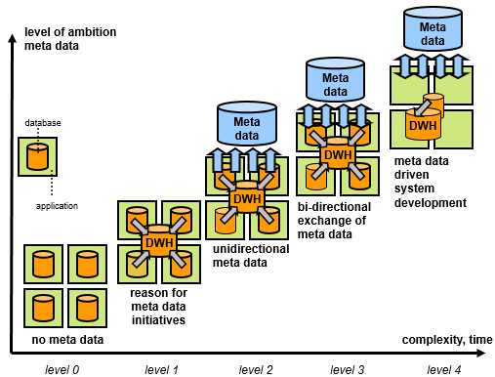
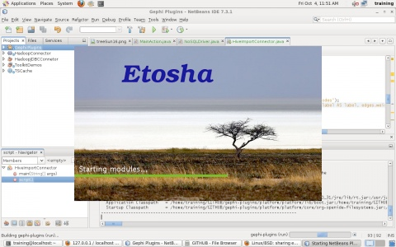
What?
future: Hybrid Cloud
now: Hadoop clusters:
.core
HCatalog & Hive
.tools

Slide 4
Why?
Etosha MDS exposes facts about your data!
Etosha MDS exposes facts from your data!
Offline or remote discovery of data sets:
Think about transient clusters!
Connect temporarily with partners!
Consistency of data and algorithms is checked on an abstracted layer.

Slide 5

How to use the tools?

Slide 6
Core Functions
collect DATASET MD (Schema, Statistics)
connect datasets with DOMAIN specific ontologies
track domain specific activities on a DATASET
expose MD to visualization tools
expose MD to query planners (Impala, Hive,Spark)
expose MD via SparkContext to processing layer

Slide 7
Schema REPOSITORY
track the schema lifecycle of a DATASET and connect it to DOMAIN-Ontologies
Each dataset has its own URI
all known facts are triplified and exposed in RDF

Slide 8
EXPOSE metadata
SPARQL interface and client side integration
EXPLORE metadata

Slide 9
EXPOSE metadata
visualize dependencies and correlations between datasets, projects, processes, resources and objectives >>> Visual and Quantitative RISK analysis based on network metrics from complex systems research

Slide 10
EXPOSE metadata

Slide 11
Explore:
Graph Browser for Relation Analysis
Assets (depending on user context)

Slide 12
Example

Slide 13
Job and Dataset Context
Q: Which job did produce a dataset by using which algorithm specific parameters at what cost? A: Build in semantic logging collects metadata in a shareable knowledge base, which is searchable and has an API for tool integration.
Transparency is achieved by traceability from final results (charts, tables), down to the code including runtime parameters and process logs.

Slide 14

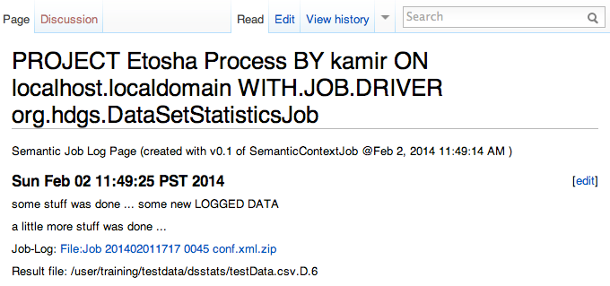
Key concept: Wiki based knowledge graph with built in semantic annotations
Transparency is achieved by traceability from final results (charts, tables), down to the code including runtime parameters and process logs.

Slide 15
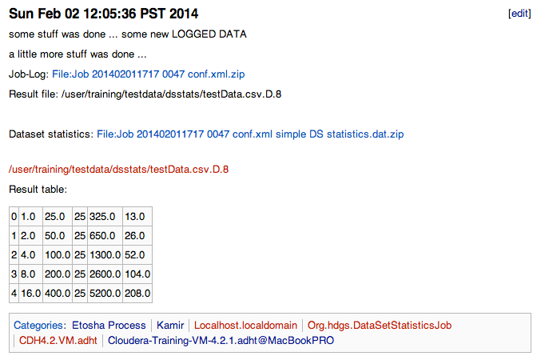
Metadata processors generate searchable / queryable results
for each column of the data set we have a row of metadata with a well defined meaning, encoded in an ontology
Transparency is achieved by traceability from final results (charts, tables), down to the code including runtime parameters and process logs.

Slide 16
Example 2

Slide 17
Dataflow & Datalink Context
Q: How can I join data from multiple Office documents without the manual export nightmare? A: Dataset integrators map content from std. Office-file types to tables in Hadoop, and allow fast access via Impala, or batch jobs via Hive and MapReduce.
Domain focused flexibility is achieved by semantic mappings.

Slide 18
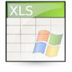

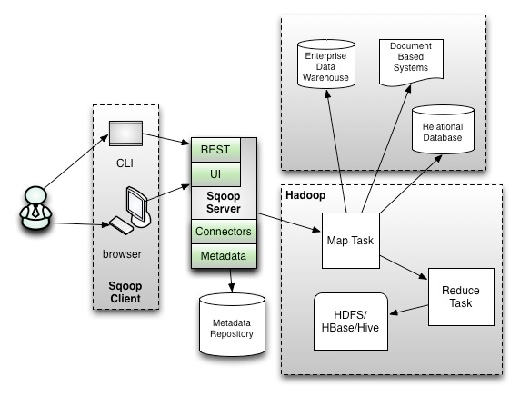


Step 2: Dataflow & link Context
key concept: semantic mapping
?
Domain Specific Documents

Slide 19

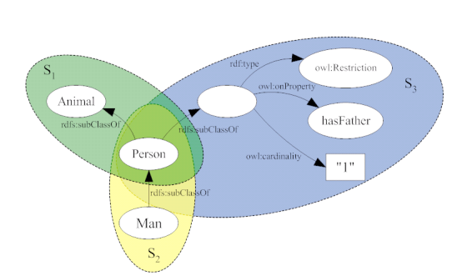

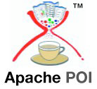
Step 2: Dataflow & link Context
Domain focused flexibility is achieved by semantic mapping definitions, which allow any kind of data extraction and migration, based on established technologies like Flume, Sqoop, JMS, and XML.
*Can also be done via Oracle SOA Suite 11g

Slide 20
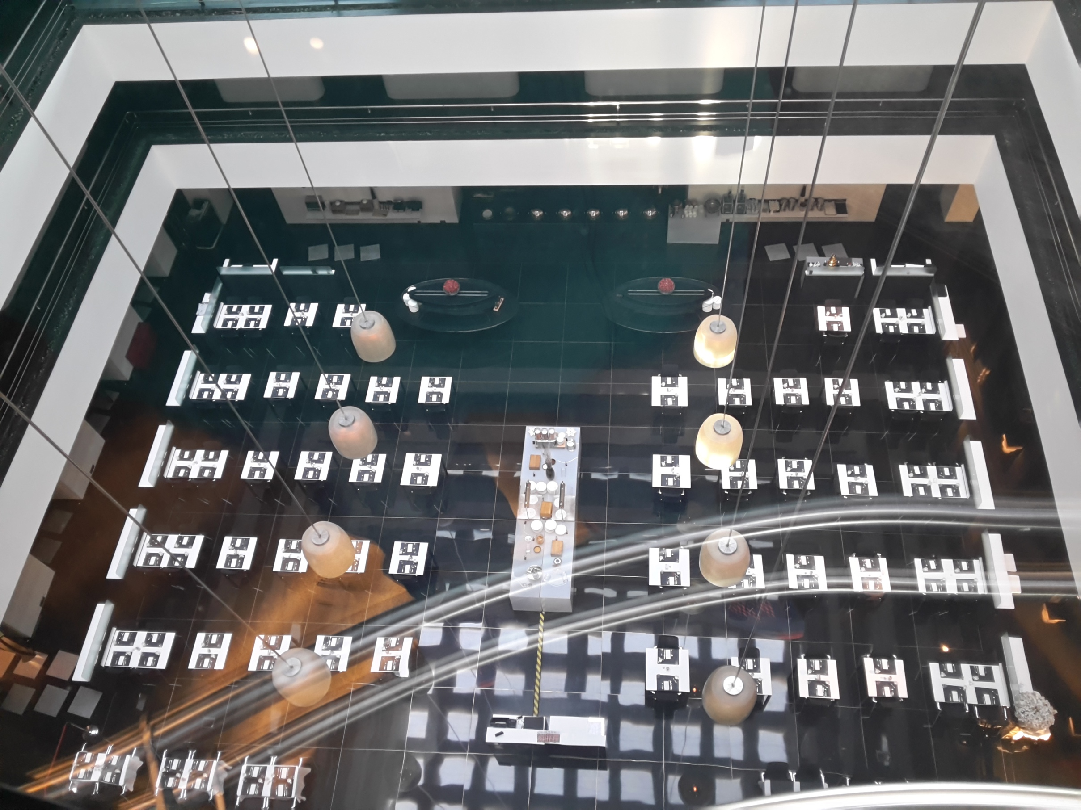
Architecture

Slide 21
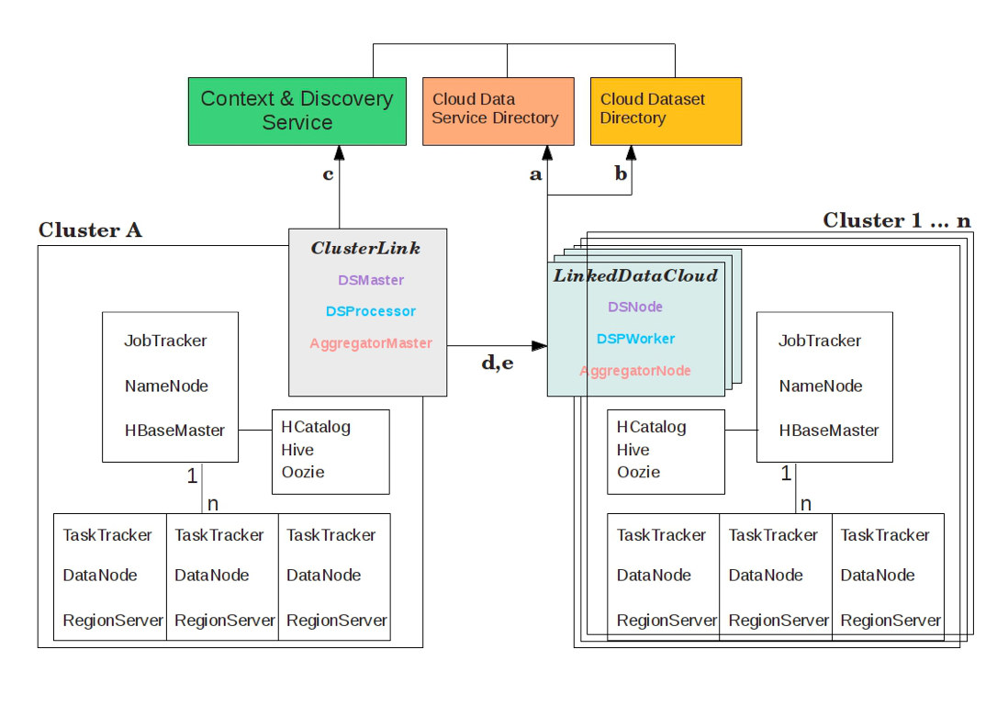
Architecture: the bird’s view
Colored boxes represent required services and can be implemented by arbitrary tools and applications. They just have to implement the dataset integration framework.
Linked Data Cloud Masters - an data set integration layer (DSI-layer) on top of multiple Hadoop clusters works based on web services and semantic web technology the concept of data locality will be achieved across multiple clusters. Cost tracking and optimization services are supportive for several business models following the Data As a Service paradigm.

Slide 22

Components core functions

Slide 23
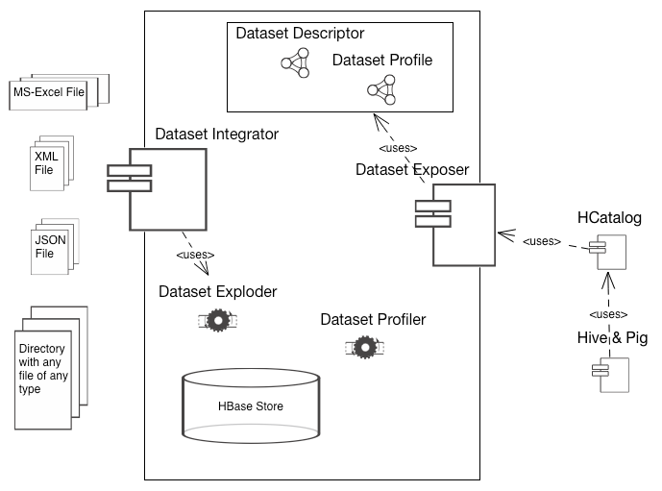
Cluster Spanning Dataset Management
Domain Knowledge
Dataset Integration
Hadoop cluster

Slide 24

Prototype:
Domain Data
Dataset Integration
SOLR & SPARQL Connector
Analysis & Discovery
Hadoop cluster
Active Role Enforcement
Context Extractor
Role Handler
Record Service
Spark or MR Profiler Jobs
Semantic Media Wiki
DocMan
Solrj
any23
HBase
SOLR
Jena

Slide 25
Release 1.0.0
Domain Data
Data & Metadata Integration
SOLR & SPARQL Connector Extractor Profiler Jobs
Hadoop clusters
Active Role Enforcement
Content Extractor Profiler Jobs
Role Handler
Record Service
Spark or MR Profiler Jobs
Etosha Core Services
WikiEnginee
Solrj
any23
HBase
SOLR
Jena/Fuseki

Slide 26
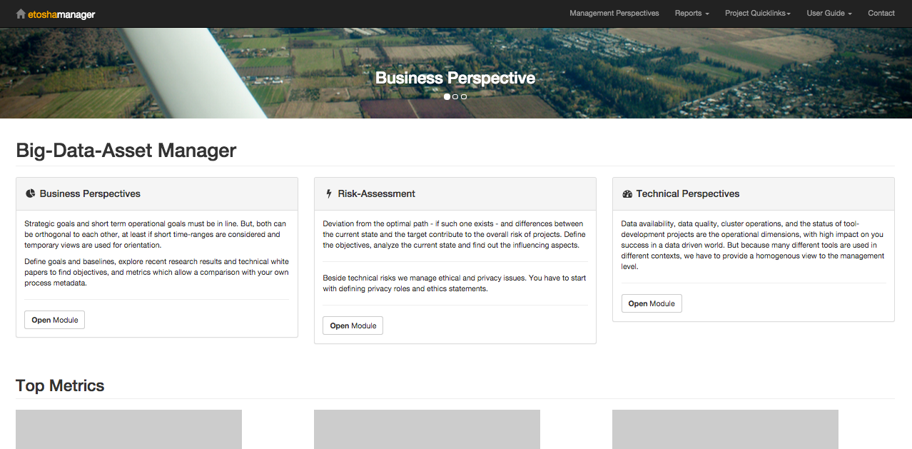
A fresh Web-UI for data exploration:

Slide 27
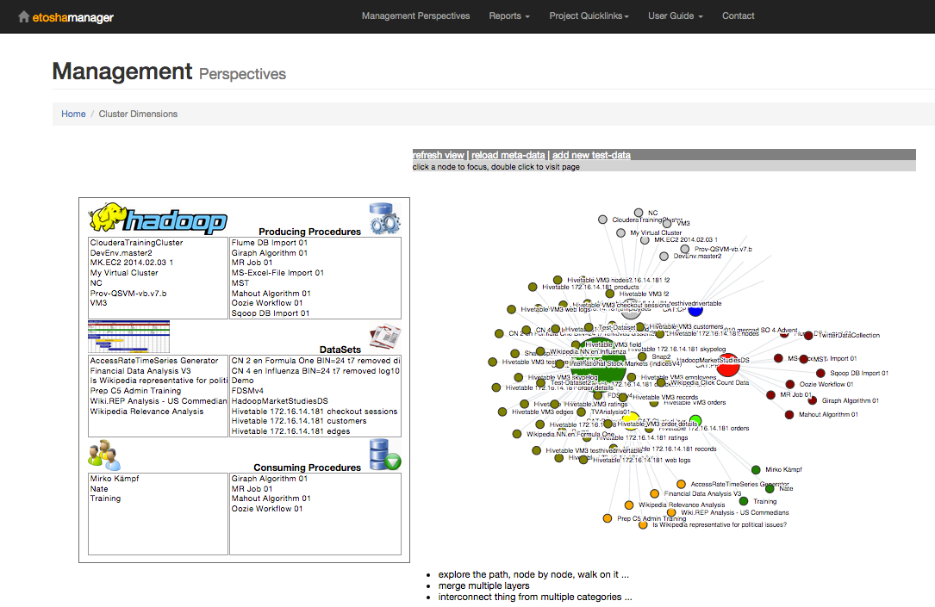

Slide 28
Dataset Profile (human readable in multi user environment)

Slide 29

Integration

Slide 30
Example: G-H-C
Gephi-Hadoop-Connector uses metadata for loading graph layers from Hadoop clusters.

Slide 31
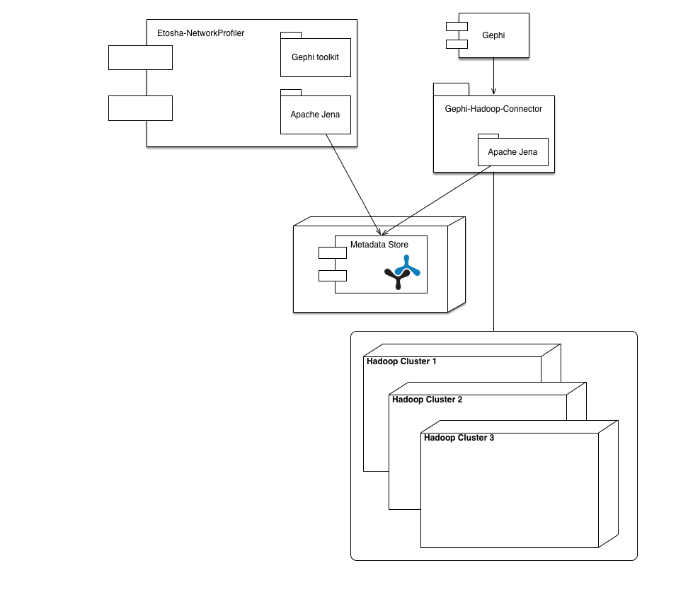
Large Networks Visualization
How to manage metadata for time dependent multi-layer networks?
Mediawiki or Fuseki/Jena are available
Gephi-Hadoop-Connector provides access to raw data: - using SQL queries on Impala - using SOLR queries

Slide 32
Metadata for Multi-Layer Networks

Slide 33
Gephi-Hadoop-Connector in Action …

Slide 34

Outlook

Slide 35
Next Steps:
Release 1.0: April 2017
finish the generic context-logger framework (reference and sample apps)
provide Web-UI (for integration in HUE)
Release 1.1: July 2017
finish Dataset-Explorer and Dataset-Profiler
Release 1.2 trelease = f( resources, contributors )
implement security model
finish the cluster spanning dataset integration layer which uses a shared semantic knowledge graph with partners

Slide 36
If data asset management matters to you, … let’s connect!
mailto:mirko@cloudera.com

